Slide 1
Recurrent Neural Networks and LSTMs
(Based on Survey paper by Yoav Goldberg and the blog by colah)

Slide 2
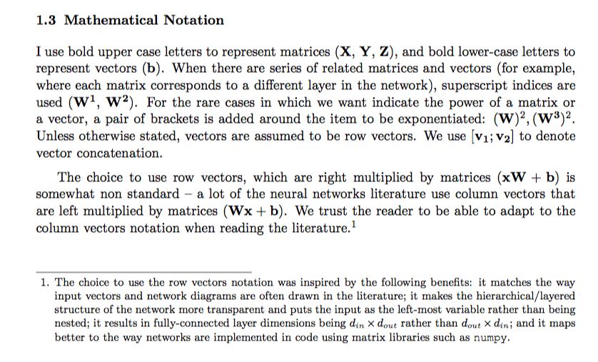

Slide 3
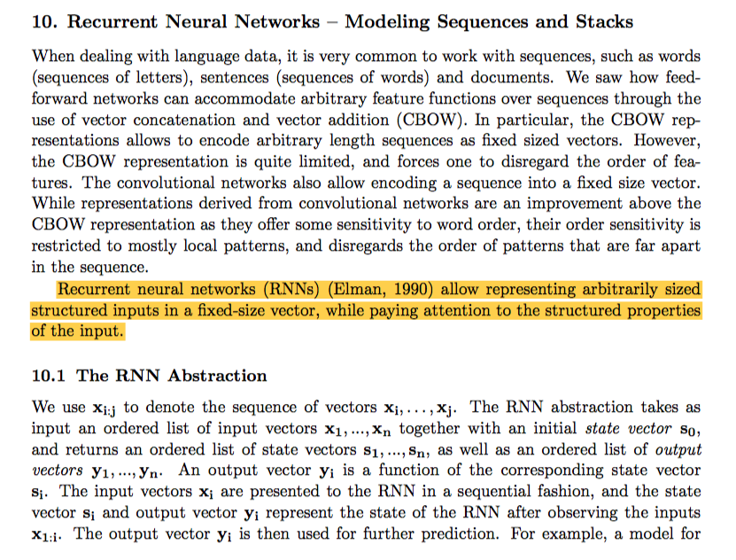
Notes:
CBOW – Continuous bag of words

Slide 4
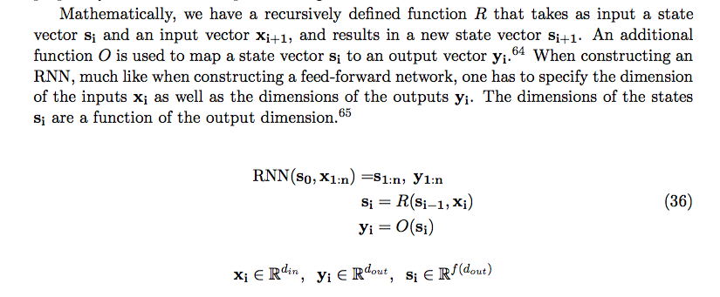

Slide 5
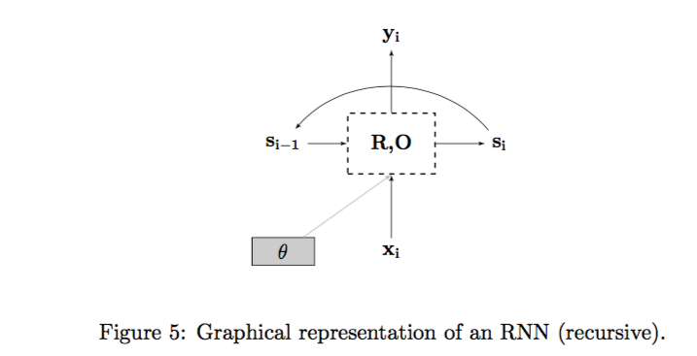

Slide 6
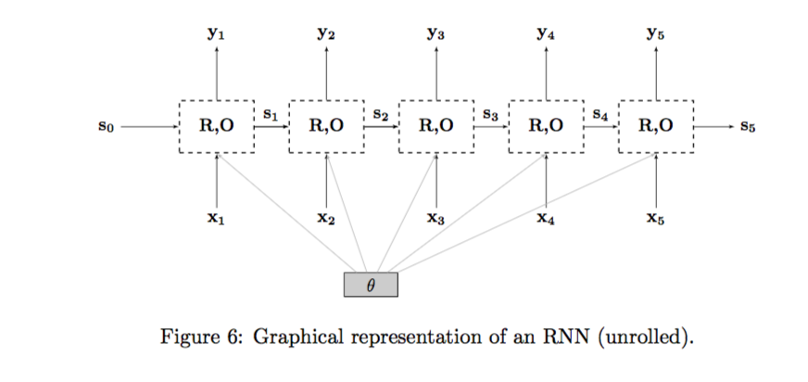

Slide 7
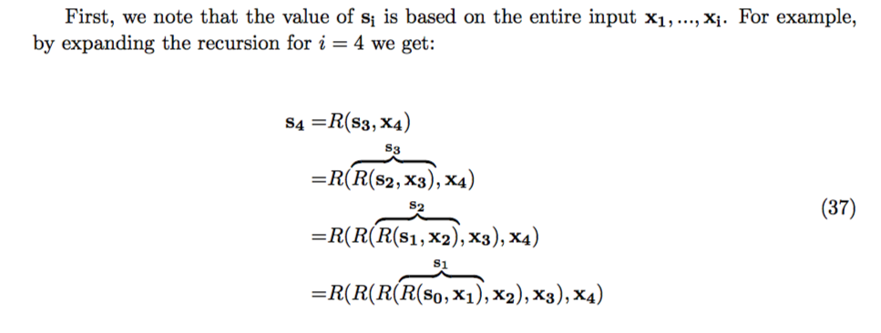

Slide 8
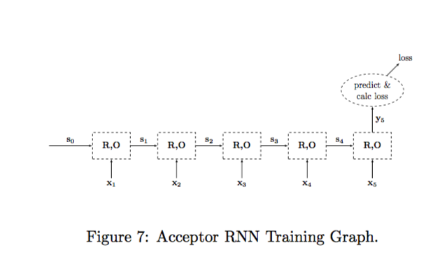

Slide 9
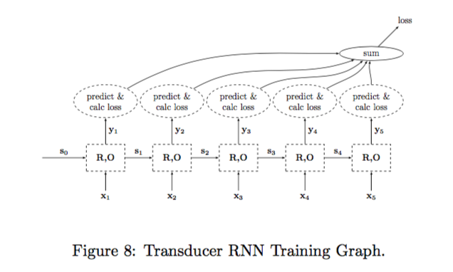

Slide 10
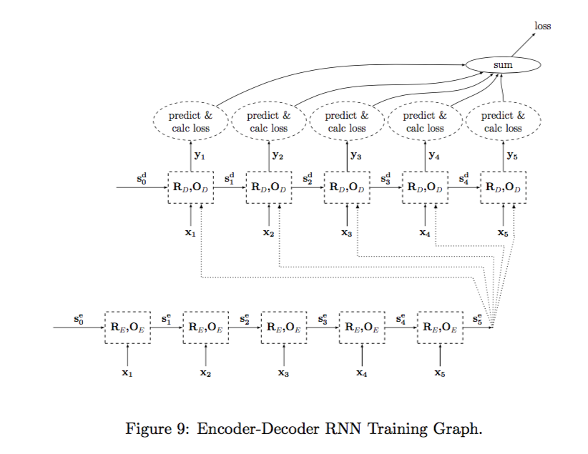

Slide 11
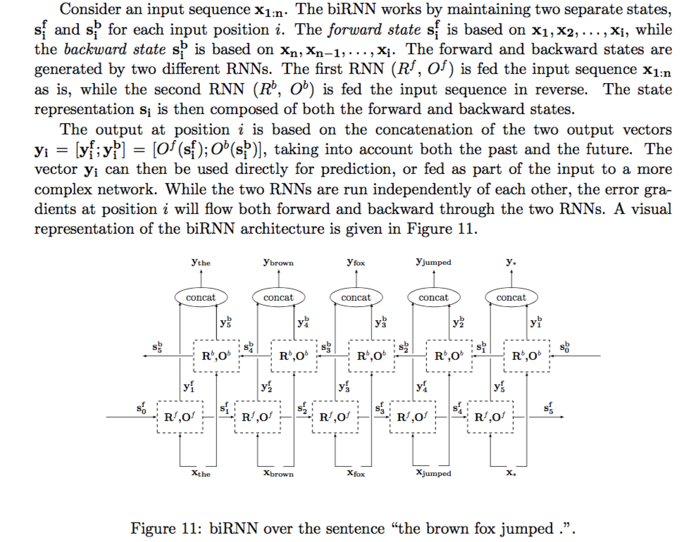
Notes:
The s and y in the backward direction seem to be mislabeled. Check the book.

Slide 12
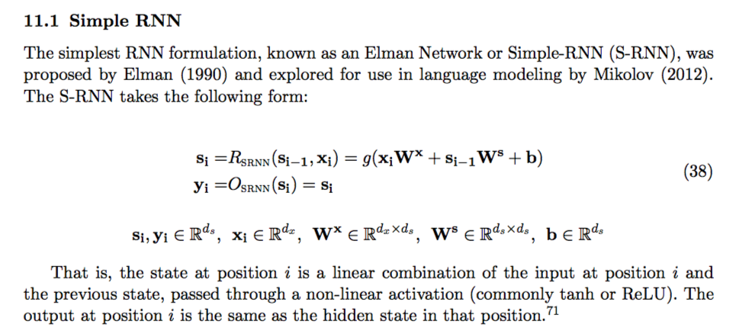

Slide 13
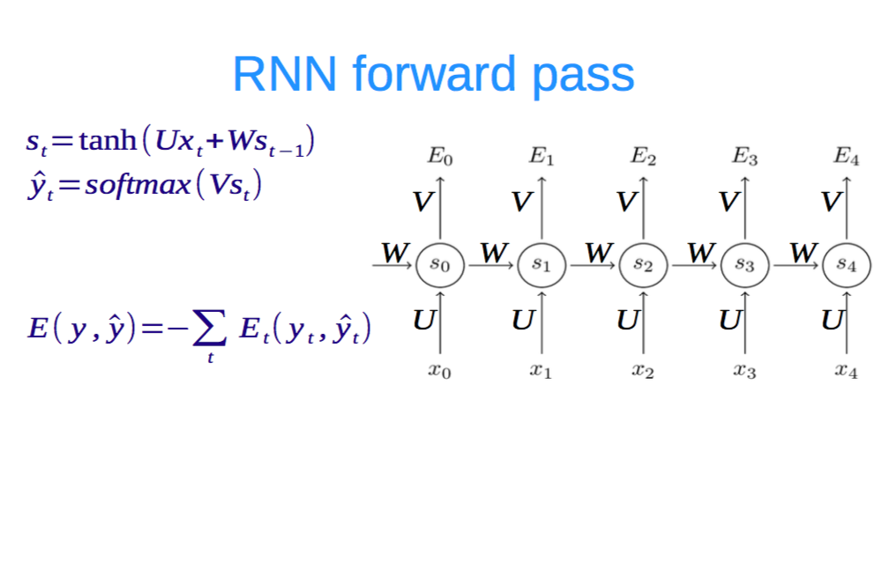

Slide 14
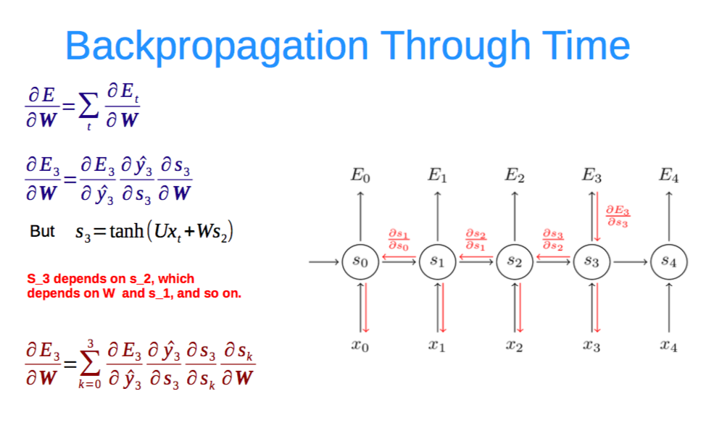

Slide 15
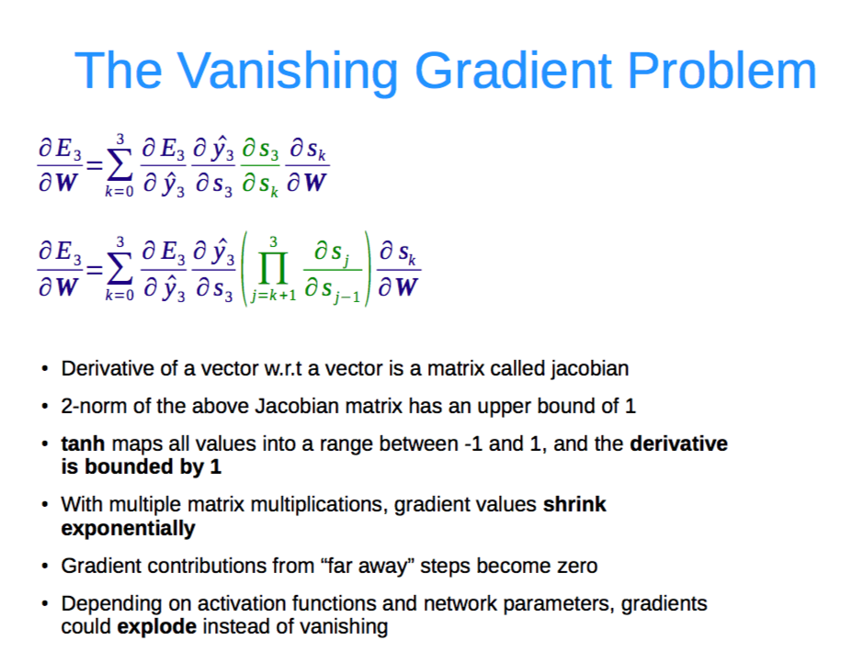

Slide 16
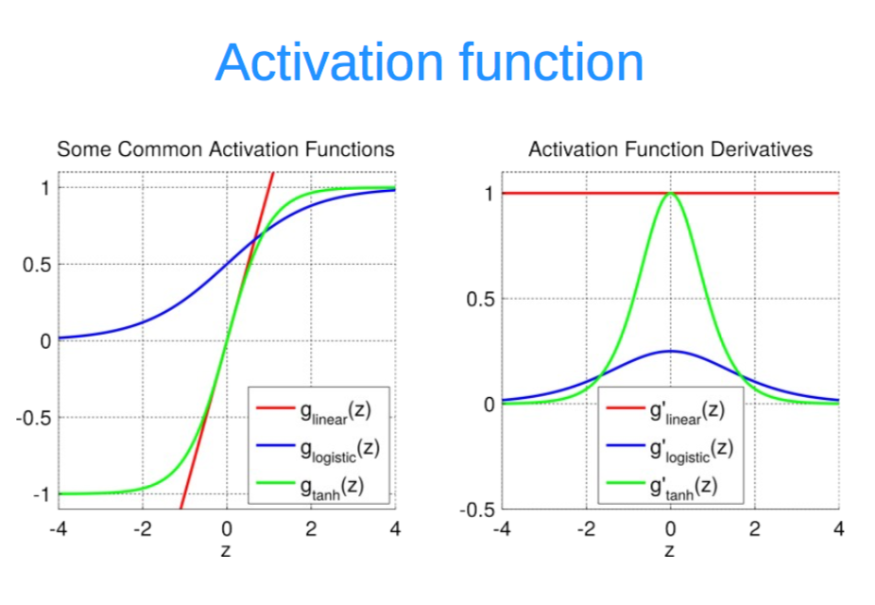

Slide 17
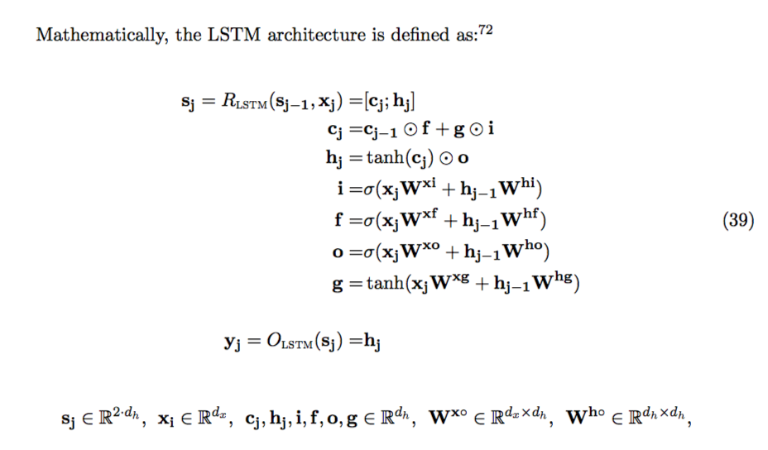
Notes:
LSTM Long Short Term Memory networks – Networks that can remember in the their short term memory, some long-term dependencies.

Slide 18
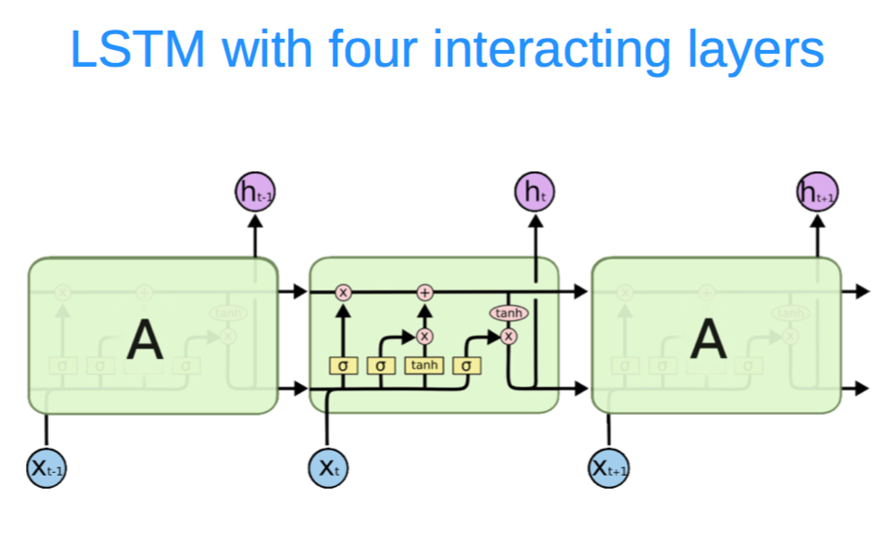

Slide 19
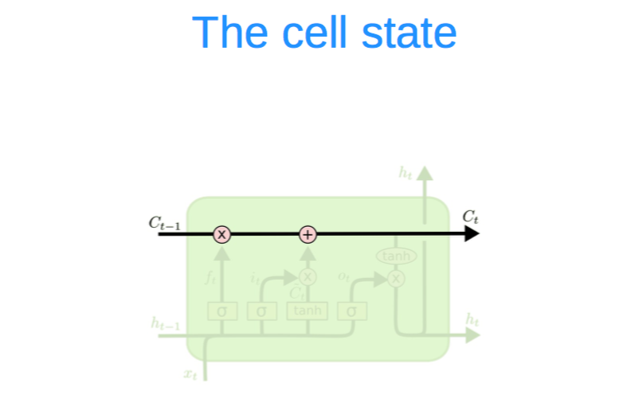

Slide 20
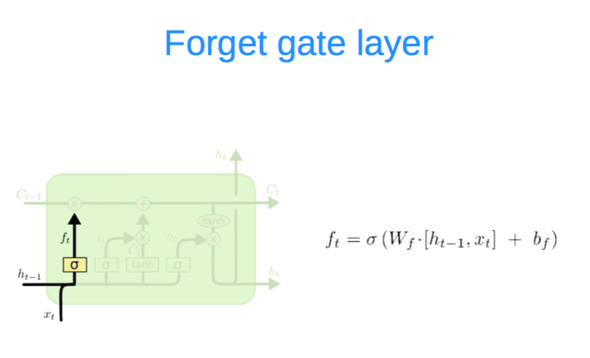

Slide 21
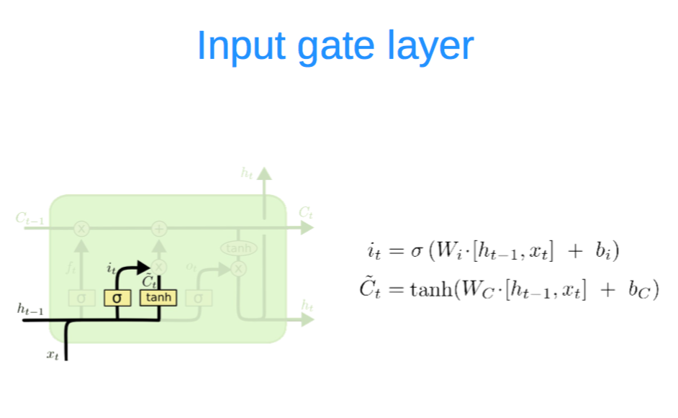

Slide 22
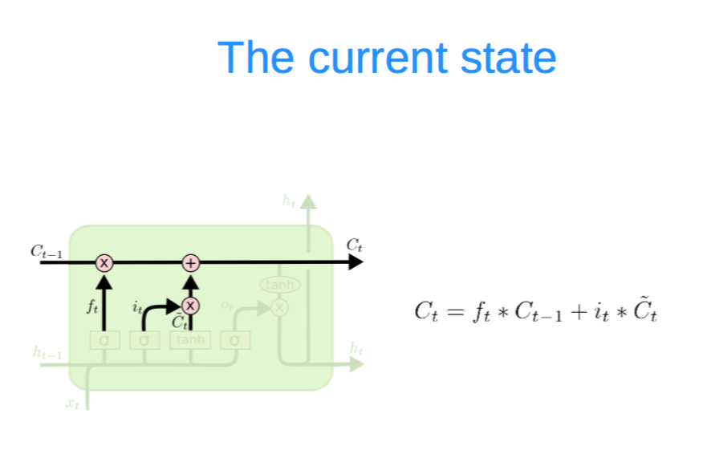

Slide 23
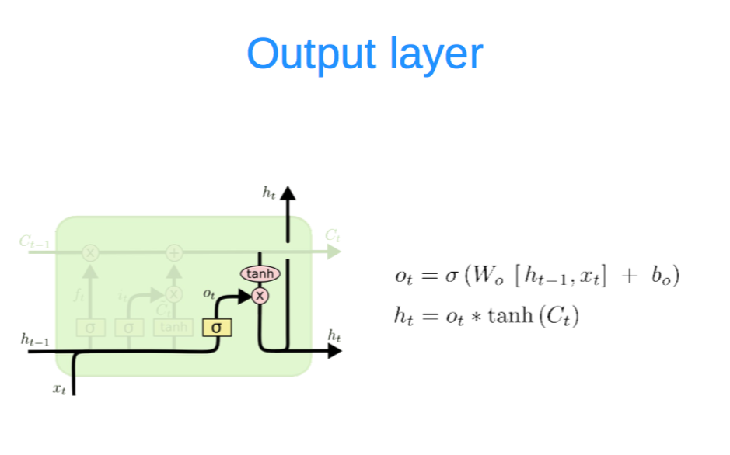

Slide 24
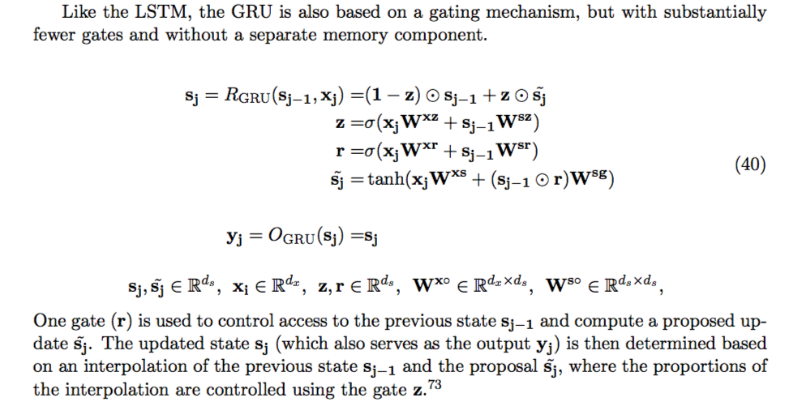

Slide 25
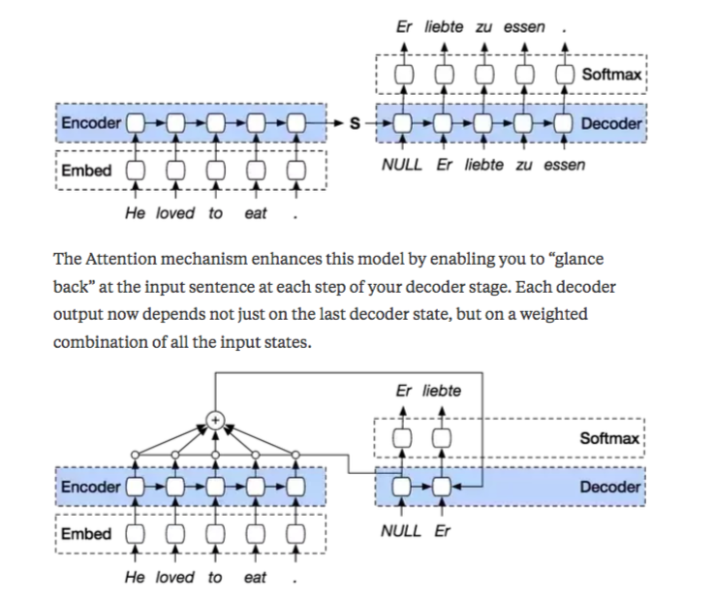
Attention Mechanism
Notes:
Attention: Weighted sum

Slide 26
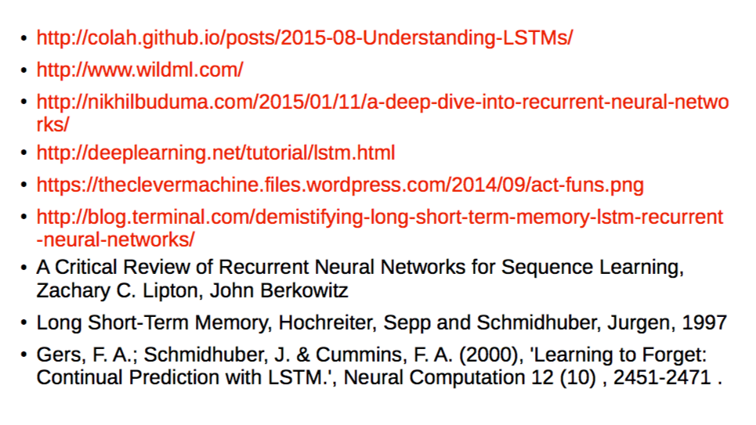
References

Slide 27
References on “Attention”
http://www.wildml.com/2016/01/attention-and-memory-in-deep-learning-and-nlp/
https://machinelearningmastery.com/how-does-attention-work-in-encoder-decoder-recurrent-neural-networks/
https://nlp.stanford.edu/pubs/emnlp15_attn.pdf

